Slide 1
Chapter 13
Judgment, Decisions, and Reasoning

Slide 2
Decisions and Reasoning
  Decisions: the process of making choices between alternatives
  Reasoning: the process of drawing conclusions

Slide 3
Inductive Reasoning (1 of 2)
  Reasoning that is based on observation
  Reaching conclusions from evidence
  Strength of argument
    Representativeness of observations
    Number of observations
    Quality of observations

Slide 4
Inductive Reasoning (2 of 2)
  Used to make scientific discoveries
    Hypotheses and general conclusions
  Used in everyday life
    Make a prediction about what will happen based on observation about what has happened in the past

Slide 5
Heuristics (1 of 7)
  “Rules of thumb” that are likely to provide the correct answer to a problem, but are not foolproof
  Two more commonly used heuristics include the availability heuristic and the representativeness heuristic

Slide 6
Heuristics (2 of 7)
Availability heuristic: events more easily remembered are judged as being more probable than those less easily remembered
More Likely | Less Likely | Percent of Participants Picking Less Likely
Homicide (20) | Appendicitis | 9
Drowning (5) | Auto-train collision | 34
Asthma (920) | Botulism | 41
Asthma (20) | Tornado | 58
Appendicitis (2) | Pregnancy | 83
Notes:
Source: Adapted from S. Lichtenstein, P. Slovic, B. Fischoff, M. Layman, & B. Combs, Judged frequency of lethal events, Journal of Experimental Psychology: Human Learning and Memory, 4, 551-578 (1978).

Slide 7
Heuristics (3 of 7)
  Illusory correlations: correlation appears to exist, but either does not exist or is much weaker than assumed
    Stereotypes: an oversimplified generalization about a group or class of people that often focuses on the negative

Slide 8
Heuristics (4 of 7)
  Representativeness heuristic
    Probability that A is a member of class B is determined by how well properties of A resemble properties normally associated with B
    Use base rate information if it is all that is available
    Use descriptive information if available and disregard base rate information
Notes:
thinking that because someone is wearing a suit and tie and carrying a briefcase, that they must be a lawyer, because they look like the stereotype of a lawyer

Slide 9
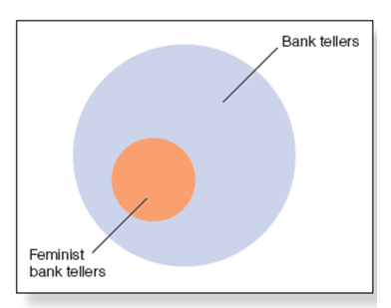
Heuristics (5 of 7)
  Conjunction rule: probability of conjunction two events cannot be higher than the probability of the single constituents
Notes:
Figure 13.1 Because feminist bank tellers are a subset of bank tellers, it is always more likely that someone is a bank teller than a feminist bank teller.

Slide 10
Heuristics (6 of 7)
  Law of large numbers: the larger the number of individuals randomly drawn from a population, the more representative the resulting group will be of the entire population
  Myside bias: tendency for people to generate and evaluate evidence and test their hypotheses in a way that is biased toward their own opinions and attitudes
  Confirmation bias: tendency to selectively look for information that conforms to our hypothesis and overlook information that argues against it

Slide 11
Heuristics (7 of 7)
  The myside bias
  Lord et al. (1979)
    Had those in favor of capital punishment and those against it read the same article
      Those in favor found the article convincing
      Those against found the article unconvincing

Slide 12
Deductive Reasoning (1 of 3)
  Determining whether a conclusion logically follows from premises
  Syllogism
    Two statements called premises
    Third statement called conclusion
  Categorical syllogism
    Describe relation between two categories using all, no, or some

Slide 13
Deductive Reasoning (2 of 3)
  Syllogism is valid if conclusion follows logically from its two premises
  If two premises of a valid syllogism are true, the syllogism’s conclusion must be true
    Do not confuse “validity” with “truth”!

Slide 14
How Well Can People Judge Validity?
  Many errors in evaluation
    Belief bias: The tendency to think that a syllogism is valid if its conclusions are believable

Slide 15
Mental Model Approach
  Mental model: A specific situation represented in a person’s mind that can be used to help determine the validity of syllogisms in deductive reasoning
    Create a model of a situation
    Generate tentative conclusions about model
    Look for exceptions to falsify model
    Determine validity of syllogism

Slide 16
Deductive Reasoning (3 of 3)
  Conditional syllogisms: “If p, then q”
  Four Syllogisms That Begin with the Same First Premise
  First premise of all syllogisms: If p, then q.
Syllogism | Second Premise | Conclusion | Is It Valid? | Judged Correctly?
Syllogism 1: Modus ponens | p | Therefore, q | Yes | 97%
Syllogism 2: Modus tollens | Not q | Therefore, not p | Yes | 60%
Syllogism 3 | q | Therefore, p | No | 40%
Syllogism 4 | Not p | Therefore, not q | No | 40%

Slide 17
The Wason Four-Card Problem (1 of 3)
  Effect of using real-world items in a conditional reasoning problem
    Determine minimum number of cards to turn over to test: if there is a vowel on one side, then there is an even number on the other side
Notes:
Imagine that each of the squares below represents a card. Suppose that you know from
previous experience with these cards that every card has a letter on one side and a number
of the other side.
You are then given this rule about these four cards:
“If a card has a vowel on one side, then it has an even number on the other side.”
Your task is to decide which of these cards you would need to turn over in order to find
out whether the rule is true or false. Indicate only those card(s) you definitely need to
turn over to determine this.

Slide 18
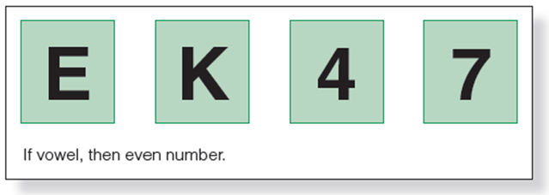
The Wason Four-Card Problem (2 of 3)
Notes:
(Source: Based on Wason, 1966)

Slide 19
The Wason Four-Card Problem (3 of 3)
  Falsification principle: to test a rule, you must look for situations that falsify the rule
    Most participants fail to do this
    When problem is stated in concrete everyday terms, correct responses greatly increase

Slide 20
Wason Test in the Real World
  Cosmides and Tooby (1992)
    Created unfamiliar situations where cheating could occur
    Participants did well
    People may be more sensitive to situations involving permissions or regulation
    From evolutionary perspective, being on the lookout for cheaters is important to survival

Slide 21
Conditional Reasoning
  Context is important
  Familiarity is not always important

Slide 22
Decision Making (1 of 9)
  Expected utility theory
    People are rational
    If they have all relevant information, they will make a decision that results in the maximum expected utility
  Utility: outcomes that are desirable because they are in the person’s best interest
    Maximum monetary payoff

Slide 23
Decision Making (2 of 9)
  Advantages for utility approach
    Specific procedures to determine the “best choice”
  Problems for utility approach
    Not necessarily money, people find value in other things
    Many decisions do not maximize the probability of the best outcome

Slide 24
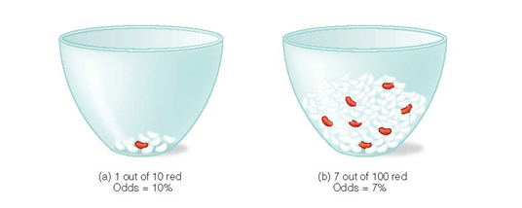
Decision Making (3 of 9)
Notes:
Figure 13.9 Denes-Raj and Epstein (1994) gave participants a choice between randomly picking one jelly bean from (a) a bowl with 1 red bean and 9 white beans or (b) a bowl with 7 red beans and 93 white beans (not all of the white beans are shown in this picture). Participants received money if they picked a red bean.

Slide 25
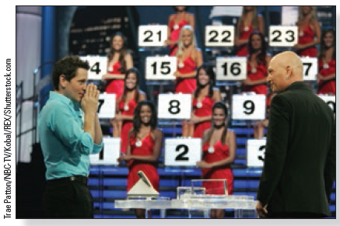
Decision Making (4 of 9)
Notes:
Figure 13.10 A decision point early in a game on the television show Deal or No Deal. The host, Howie Mandel, on the right, has just asked the contestant whether he wants to accept an offer made by the bank (Deal) or continue the game (No Deal). In the background, models stand next to numbered briefcases that have not yet been opened. Each of these briefcases contains an unknown amount of money. The contestant’s briefcase, not shown here, also contains an unknown amount of money.

Slide 26
Decision Making (5 of 9)
  Emotions affect decisions
  Expected emotions
    Emotions that people predict that they will feel concerning an outcome
  People inaccurately predict their emotions

Slide 27
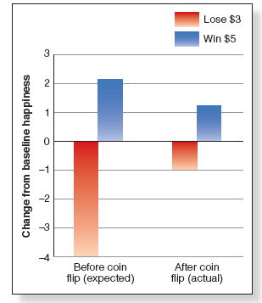
Decision Making (6 of 9)
Notes:
Figure 13.11 The results of Kermer et al.’s (2006) experiments showing that people greatly overestimate the expected negative effect of losing (left red bar), compared to the actual effect of losing (right red bar). The blue bars indicate that people only slightly overestimate the expected positive effect of winning (left blue bar), compared to the actual effect of winning (right blue bar).

Slide 28
Emotions
  Incidental emotions: Emotions that are not specifically related to decision making
    May be related to one’s general disposition or personality, recent experience, or one’s general environment or surroundings
    Can affect one’s overall decision-making processes

Slide 29
Decision Making (7 of 9)
  Decisions depend on how choices are presented
    Opt-in procedure
      Active step to be organ donor
    Opt-out procedure
      Organ donor unless request not to be
  Status quo bias
    Tendency to do nothing when faced with making a decision

Slide 30
Risk-Taking Strategies
  Risky decisions
    Risk aversion strategy used when problem is stated in terms of gains
    Risk-taking strategy when problem is stated in terms of losses

Slide 31
Decision Making (8 of 9)
  Framing effect: decisions are influenced by how a decision is stated
    Can highlight one aspect of situation
      Tversky and Kahneman (1981)
      When situations are framed in terms of gains, people tend toward a risk aversion strategy
      When situations are framed in terms of losses, people tend toward a risk-taking strategy

Slide 32
The Physiology of Thinking (1 of 4)
  Neuroeconomics
    One finding: decisions are influenced by emotions, and those emotions are associated with activity in specific areas of the brain

Slide 33
The Physiology of Thinking (2 of 4)
  Sanfey et al. (2003)
    Ultimatum game
    Often rejected low offers because they became angry that offers were unfair
    Less angry with an “unfair” computer

Slide 34
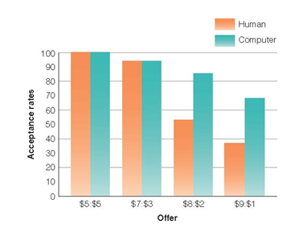
The Physiology of Thinking (3 of 4)
Notes:
Figure 13.14 Behavioral results of Sanfey et al.’s (2003) experiment, showing responders’ acceptance rates in response to different offers made by human partners and computer partners.

Slide 35
The Physiology of Thinking (4 of 4)
  Sanfey et al. (2003)
    More activation of right anterior insula (connected with emotional states), participants more likely to reject more offers
    Emotion is important in decision making

Slide 36
The Dual Systems Approach to Thinking
  Kahneman (2011)
    Two mental systems
  System 1: fast, automatic, intuitive, nonconscious
  System 2: slower, deliberative, conscious, controlled
    Much of our day-to-day existence is handled by System 1
    System 2 takes over when we need to be more thoughtful

